Slide 1
A Sustainability Framework for Smart Learning Factories Based on Using Structured Information as Semantic Models
Ragu Athinarayanana, Sangje Choa , Balamurugan Balakreshnan

Slide 2
Use Case
Create a framework to collect sustainability data from plants
Data source can be internal or external
Common data model to store the sustainability information
Ability to report on carbon consumes and used
Ability to collect data from various Assembly lines and stations
Even the power sources or gas sourcesused

Slide 3
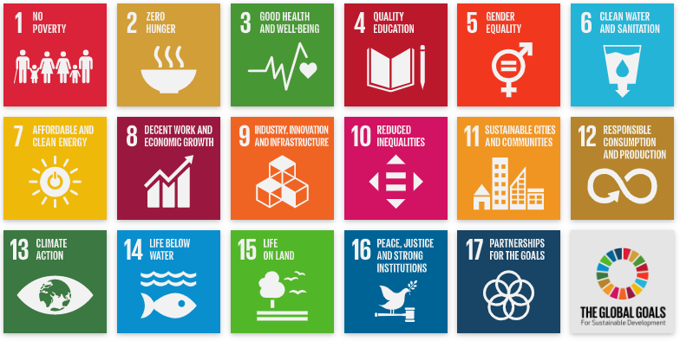
UN Sustainable Development Goals (SDGs)
We don’t need to define sustainability categories, as this is done by the United Nations.
https://www.un.org/sustainabledevelopment/sustainable-development-goals/
Notes:
The United Nations defined sustainability as “meeting the needs of the present without compromising the ability of future generations to meet their own needs.”
In 2015, all 190 United Nations Member States adopted the 2030 Agenda for Sustainable Development(https://sustainabledevelopment.un.org/post2015/transformingourworld) , a shared blueprint for peace and prosperity for people and the planet, now and into the future. At its heart the 17 Sustainable Development Goals (SDGs), are an urgent call for action by all countries - developed and developing - in a global partnership. They recognize that ending poverty and other deprivations must go hand-in-hand with strategies that improve health and education, reduce inequality, and spur economic growth – all while tackling climate change and working to preserve our oceans and forests.
Sustainable development requires an integrated approach that takes into consideration environmental concerns along with economic development.
For additional content on UN SDG connect with Andreea Bulisache (andreeab)

Slide 4
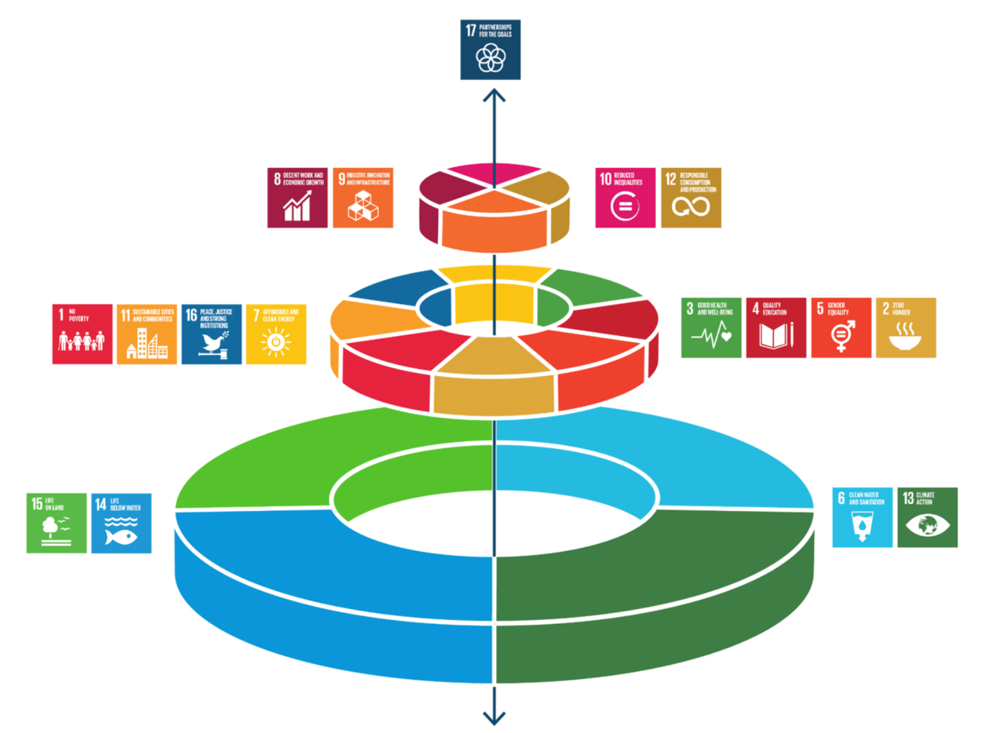
Sustainability – as a 3-lens view
Microsoft’s Commitment to SDGs – link
UN Global Compact Communication on Progress
Economic
direct attention towards industry, innovation and infrastructure;
reduced inequalities;
responsible consumption and production;
and decent work and economic growth that is decoupled from environmental degradation
Societal
eradication of poverty, and the improvement of social justice, peace and good health.
social development depends upon a protected environment;
the goals on clean energy, no poverty, zero hunger, peace and justice, sustainable cities, education, gender equality and good health;
En
Environmental (Microsoft Priority)
Protecting the environment is an essential precondition for social justice and economic development. If we do not achieve the goals related to clean water and sanitation, life below water, life on land, and climate action, the world will fail to achieve the remaining goals;
Notes:
The 17 SDG are classified in 3 categories:
Economical: Decent work & Economic Growth(#8 ) Industry , Innovation & Infrastructure (#9), Reduced Inequality (#10), Responsible consumption and production (#12)
Societal: No Poverty (#1), Zero Hunger (#2), Good Health and Well-Being (#3), Quality Education (#4), Gender Equality (#5), Affordable and Clean Energy (#7), Sustainable Cities and Communities (#11), Peace, Justice, and strong Institutions (#16)
Environmental : Clean Water and sanitation (#6) , Climate Action (#13), Life Below Water (#14), Life on Land (#15)
Most Top500 companies have an existing Sustainability Strategy ( also referred to as CSR – Corporate Social Responsibility) that its publicly communicated in annual reports ad corporate website. Often, they will refer to their actions/ efforts using the 17 SDG, UN provided clear metrics depicted in the following slide or internal ROI.
For additional content on UN SDG connect with Andreea Bulisache (andreeab)

Slide 5


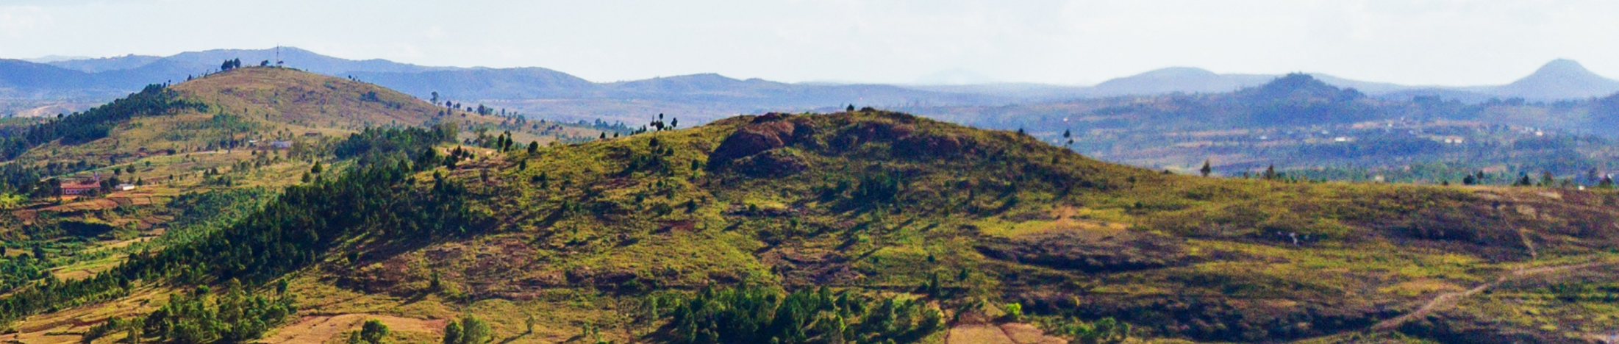




Investing to build the leading platform for technology solutions to environmental challenges​
Products & Services
Preferred platform and products for environmental solutions
Carbon
Water
Operations
Align with science and international goals
Customers & Partners
Trusted partner for customers’ sustainability journeys
Employees
Policy
Advocate for policies to achieve corporate and societal goals
Waste
Ecosystems
Notes:
At Microsoft, we are invested in building the world’s leading platform for technology solutions to environmental challenges.
Many companies, including ours, map their sustainability and Corporate Responsibility strategies to the UN Sustainability Development Goals (or SDGs) adopted by all 190 UN member states as part of the 2030 Agenda for Sustainable Development.
We support all of the UN goals. But we are focusing today on environmental sustainability in the four key areas of carbon, water, waste, and ecosystems.
Our goal is to use the whole of Microsoft's business power to affect change in those areas by minimizing the negative impacts of our operations and maximizing the positive impacts of our technology.
While we’ve long been focused on operating our business as efficiently as possible – increasingly, we’re taking responsibility for our carbon, water, waste, and land footprints across our products and facilities, including our supply chain.
We are developing new products and services driven by data, AI, and digital technology to power environmental sustainability.
We’re delivering new features and benefits to help customers and partners better understand and manage their environmental impact.
We will use our voice on climate-related public policy issues and support new policy initiatives to help us all move faster.
As our most important asset, our people are the ones developing these technologies, and collectively they are a powerful voice for change. They have continued to push us in new directions, and we know that they’ll continue to do so.
Of the four environmental areas where we are focused, carbon is the area where we’ve invested the most, and every industry has a carbon footprint that they will increasingly have to manage.
We see water as inextricably linked to carbon since it’s often used to produce energy. It's a byproduct and a necessary ingredient for most industries, but it's also a necessary ingredient for life, which means conserving water in industry leaves more for people. Getting that balance right is important.
It’s also important that we thoughtfully manage ecosystems and the land that we use, leveraging technology to help us better understand and interact with our planet sustainably.
And finally: waste. And really what we mean here is circular economy. For us, that means understanding every material we use as it is sourced, manufactured, operated, and managed all the way to its end of life – and prioritizing the most sustainable choices we can make throughout that cycle.
Keep in mind, this approach and focus we’ve built doesn’t evolve overnight. It’s been a journey.
<CLICK>

Slide 6

Our core environmental sustainability commitments
Carbon negative
Water positive
Zero waste
Build the Learning Factory
Notes:
So, in January 2020, we announced a bold commitment and detailed plan to operate with 100% renewable energy by 2025 and be carbon negative by 2030. We built on that pledge with a series of industry-leading commitments to be a water positive, zero waste company by 2030, and develop a new Planetary Computer to better monitor, model, and manage the world’s ecosystems and protect more land than we use.
Across the company, our teams are driving these ambitious goals internally – and helping set best practices and new standards for businesses around the world.
For our corporate sustainability commitments to make the broadest impact, we need to ensure that the world is working from a common taxonomy and common units and methods of measurement. We’re targeting 2030 as a milestone for standardizing digitized sustainability data.
<CLICK>

Slide 7
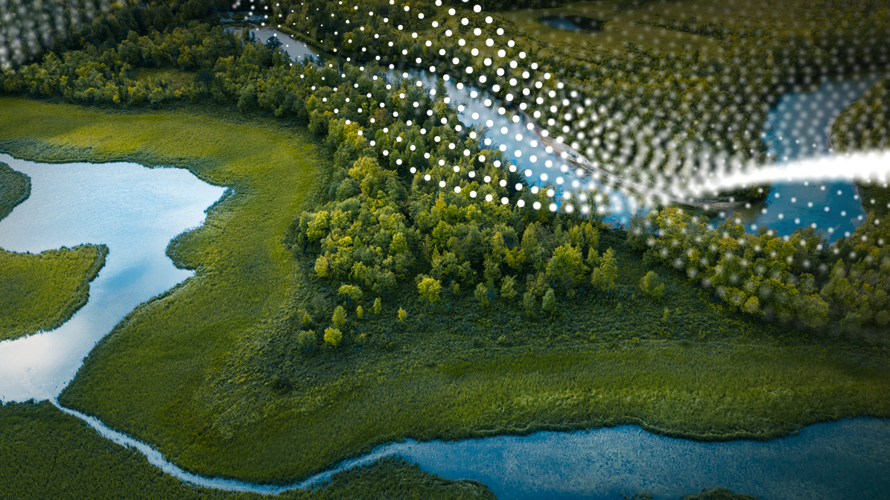

Microsoft Cloud for Sustainability
Delivering insights to help you accelerate every stage of your organization’s sustainability journey
Comprehensive
Integrated
Automated
Record
Report
Reduce
Remove
Replace
Notes:
And soon… Microsoft will be launching the new Microsoft Cloud for Sustainability, providing comprehensive, integrated, and automated sustainability management for organizations at any stage of the sustainability journey. It’s designed to streamline the process for businesses to collect data, analyze data, and turn insights into action.
<CLICK>
The new Microsoft Cloud for Sustainability will enable you to more effectively record, report, and reduce your emissions on a path to net zero, with future plans to support water and waste tracking.
The Microsoft Cloud for Sustainability is a SaaS-based offering that:
connects to real-time data sources,
accelerates data integration and reporting,
provides accurate carbon accounting,
shows performance against goals, and
provides intelligent insights to enable any organization to take more effective action on sustainability.
Go to Microsoft.com/sustainability to sign up for ongoing updates—particularly about how this will help you accelerate your net zero goals.
<CLICK>

